Slide 1
UPLOAD AN DOWNLOAD SYSTEM
Jhon Rivero Torrez

Slide 2
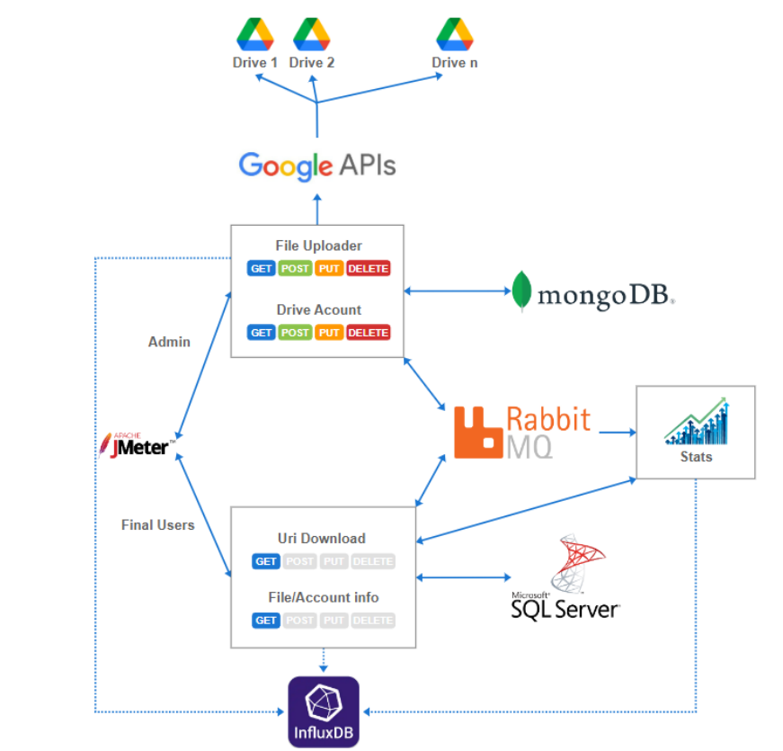

Slide 3
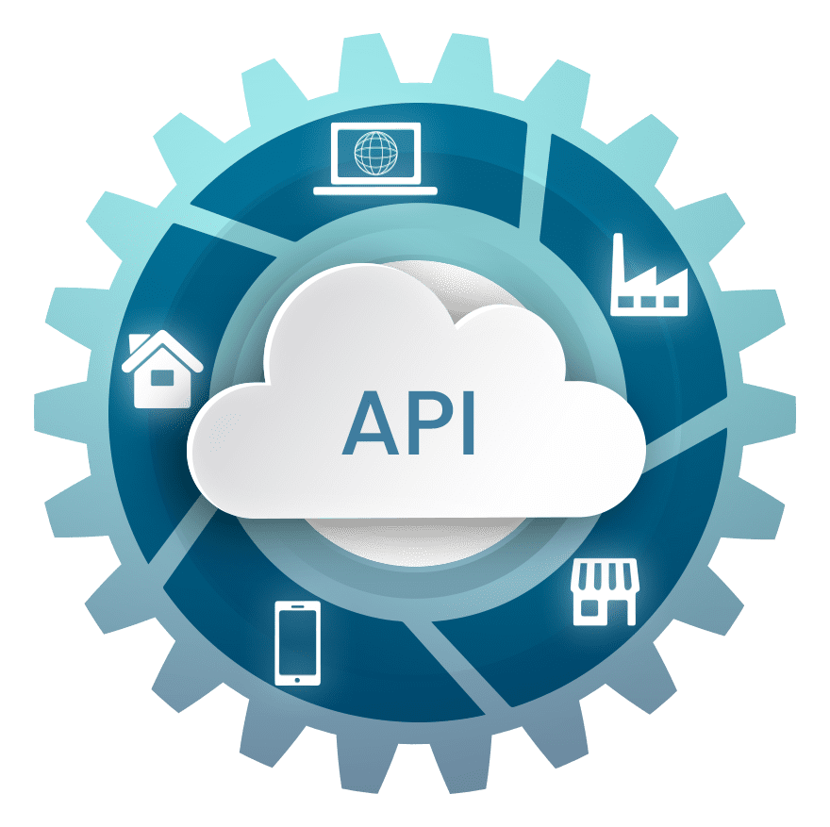


How it works
Downloader
UPloader
Stats

Slide 4
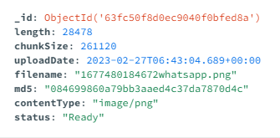
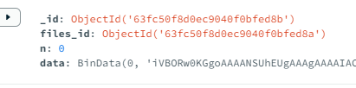
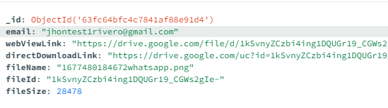
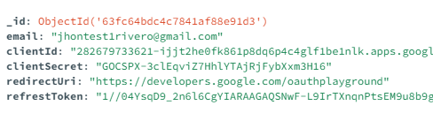
Mongo db structure
GriFs
MongoDB
Google drive entity
Account entity

Slide 5
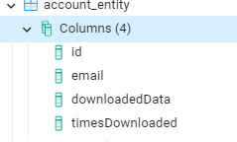
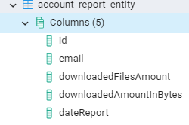
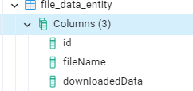
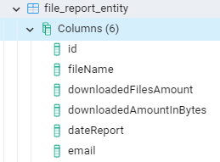
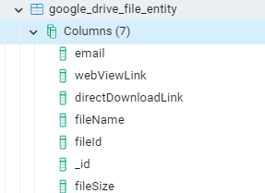
postgres structure

Slide 6
Upload File request
Upload to gridfs
Upload to Google drive
Save Google drive links
Send rabbitmq to downloader
Create downloader Google drive links

Slide 7
Update File name request
Update filename on gridfs Update filename on Google drive files
Upload filename on Google drive
Send rabbitmq to downloader
Update filename on Google drive files

Slide 8
DownLoad File request
Get Google drive files
Send rabbimq to stats
Statistics create reports
Statitics sent http reques to downloader
Create reports

Slide 9
Delete Account request
Delete Google drive files from account Delete account from database
Send rabbimq to downloader
Delete reports from account
Delete Google drive files from account

Slide 10
Delete File request
Delete Google drive files Delete file from gridfs
Send rabbimq to downloader
Delete reports from file
Delete Google drive files

